Slide 1
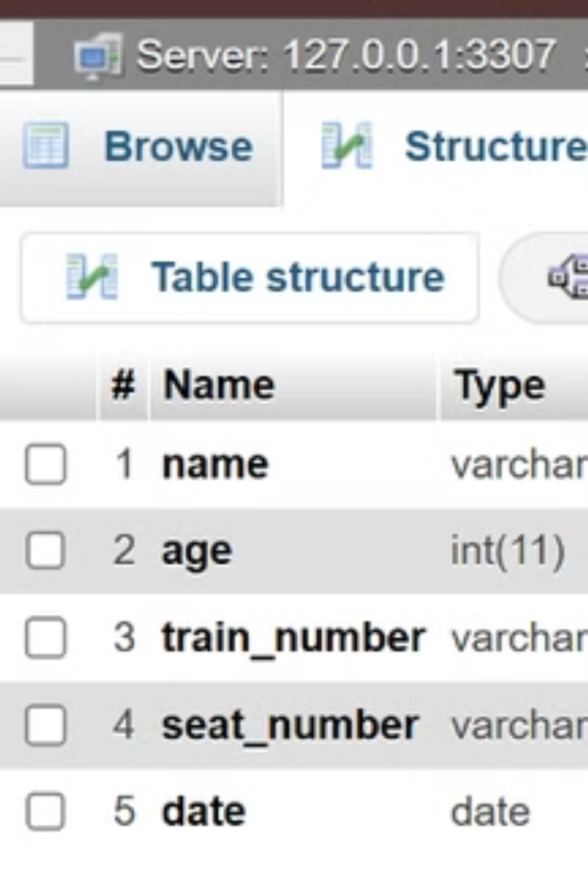
Railway Reservation System
The Railway Reservation System is a software solution designed to streamline the process of booking train tickets. This system allows users to enter details such as their name, train number, seat number, and date of travel to book tickets efficiently.
DM
by DEEPIKA M

Slide 2

Introduction
The railway network is a vital infrastructure for mass transportation, offering a cost-effective and efficient means of travel. With millions of passengers relying on trains daily, an efficient and user-friendly ticket booking system is essential. Traditional manual booking systems often suffer from inefficiencies, inaccuracies, and long processing times. To address these challenges, the Railway Reservation System was designed and implemented.

Slide 3

Objectives
1
Automation of Ticket Booking
2
Real-Time Availability
To enable users to check the real-time availability of trains, seats, and schedules for a hassle-free reservation experience.
To replace the manual ticket booking process with a computerized system that provides faster, more accurate, and efficient booking services for passengers.
3
Data Integrity and Security
4
Ease of Use
To design a user-friendly interface that simplifies the reservation process for users, requiring minimal technical expertise to navigate and operate.
To ensure the secure handling of user data, booking records, and train schedules by implementing robust database management practices using MySQL.

Slide 4
Modules
Database Module
Train Management Module
Booking Module
Manages all interactions with the database, establishing secure connections and executing queries for data storage and retrieval.
Handles all operations related to train information, retrieving train schedules and other relevant details from the database for users to make informed choices.
Captures user inputs and processes ticket bookings, validating the entered details and storing the booking information in the database.

Slide 5
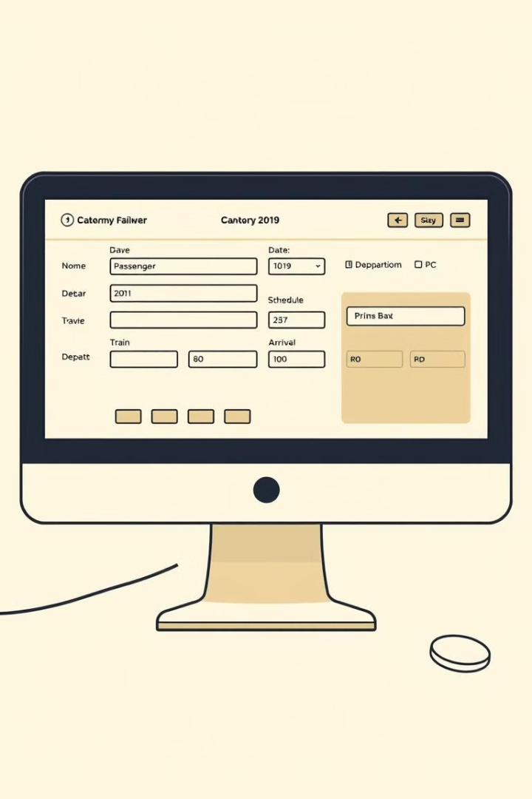
Software Description
The Railway Reservation System is a Java-based software designed to automate the process of booking train tickets. It provides a user-friendly interface for entering booking details such as passenger name, train number, seat number, and travel date, while securely managing data in a MySQL database. The system ensures efficiency, accuracy, and convenience for both users and administrators.

Slide 6
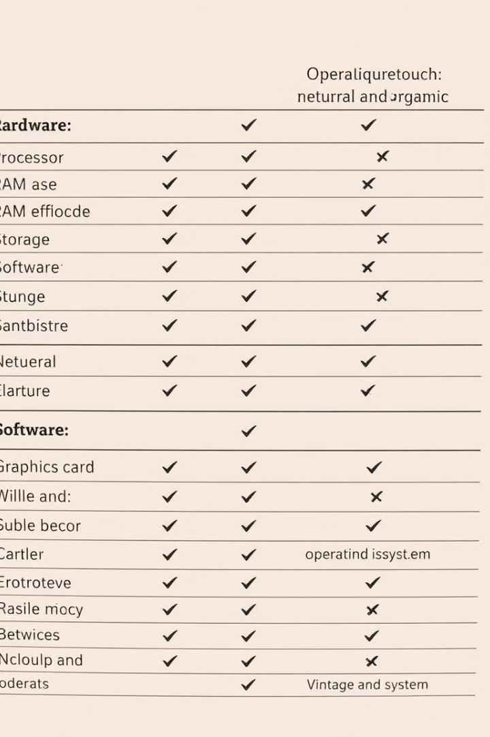
Requirements and Analysis
Operating System
Windows, Linux, or macOS
Java
JDK 8 or higher
Swing
For creating the graphical user interface
MySQL
For the database management system (DBMS)
PhpMyAdmin
To manage the MySQL database through a web interface
Processor
Dual-core processor (or higher)
RAM
Minimum of 4 GB
Storage
Minimum of 100 MB available disk space

Slide 7
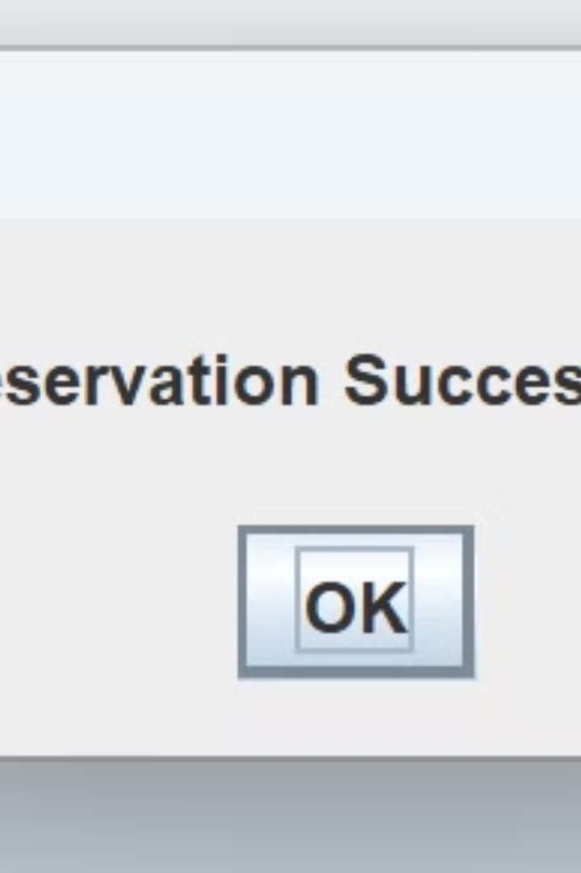
Results and Discussion
The Railway Reservation System demonstrates a successful implementation of a simplified and efficient train reservation platform. The system's user-centric design and functional capabilities provide several valuable insights into its development, usability, and scope for further enhancement.

Slide 8

Conclusion
The Railway Reservation System successfully achieves its primary goal of providing a simple, functional, and efficient platform for booking train tickets. The user-friendly interface ensures that the booking process is intuitive and straightforward, while the tabular display of reservation data enhances administrative oversight. The system demonstrates reliable performance, handling multiple reservations without errors, and serves as a foundation for building more advanced reservation systems.

